Slide 1
Neuromni
Providing concurrency and version control for user-edited dynamic connected components
Zoe Ashwood
Sven Dorkenwald
Thomas Macrina

Slide 2
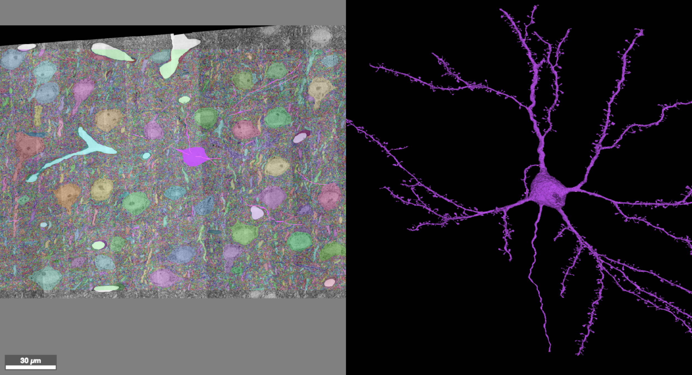
Problem Overview
Our lab uses deep learning to reconstruct neurons from EM images

Slide 3
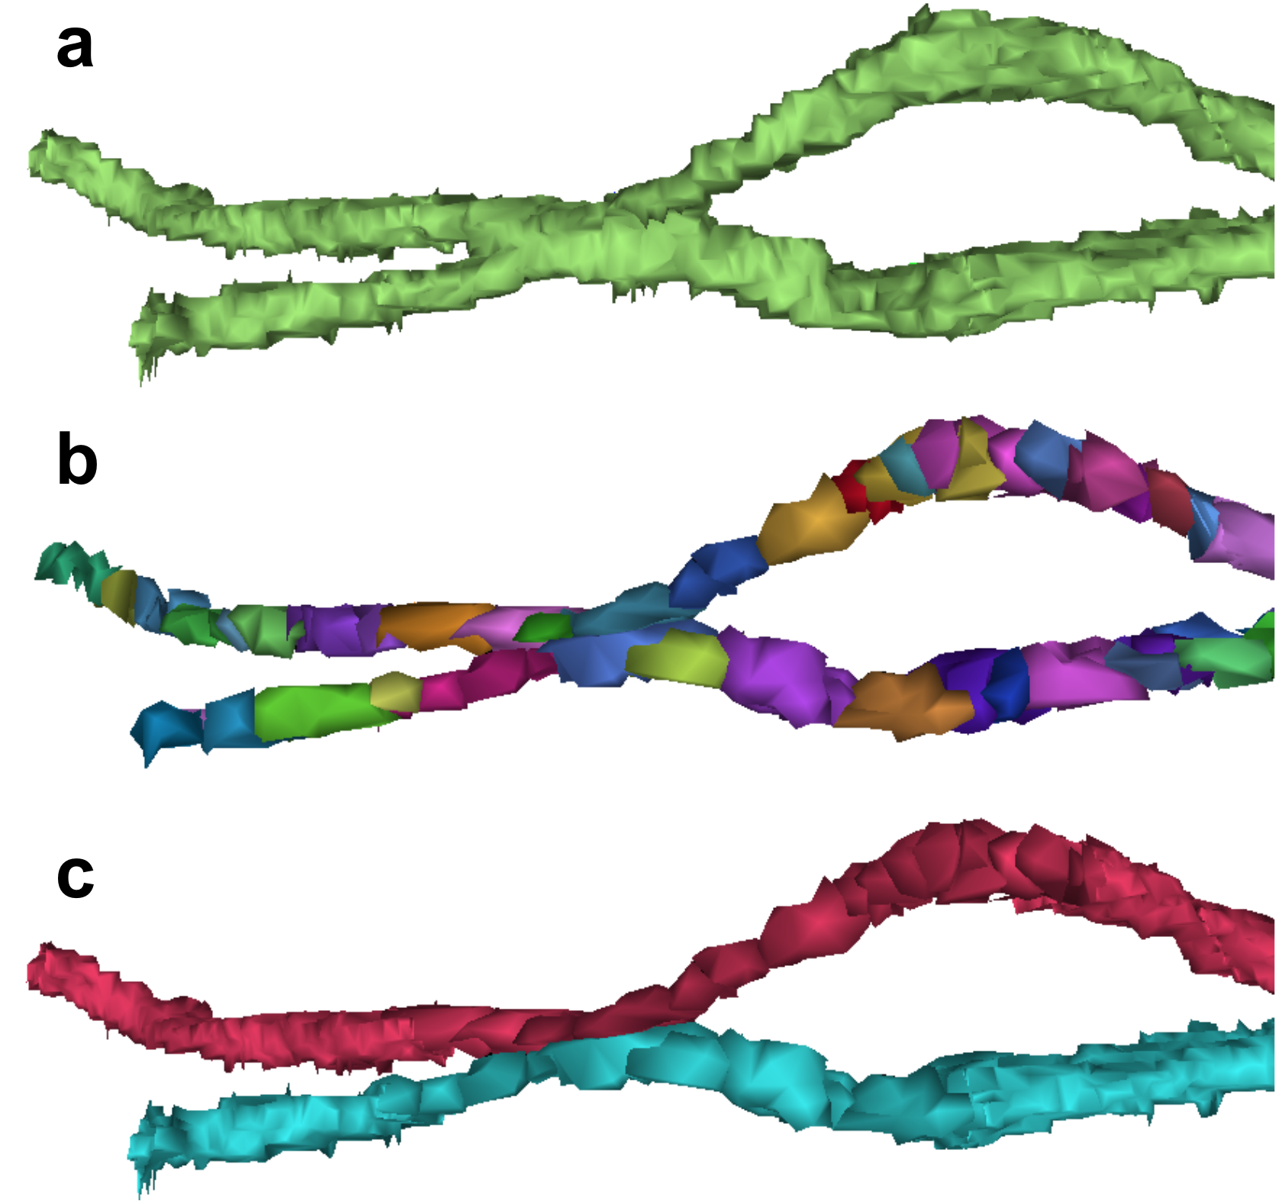
Problem Overview
Many of the neurons are imperfect!
merged neurons

Slide 4
Problem Overview
Many of the neurons are imperfect!
merged neurons
supervoxels (immutable objects)

Slide 5
Problem Overview
Many of the neurons are imperfect!
merged neurons
supervoxels (immutable objects)
correct agglomeration

Slide 6
Problem Overview
Spatially aware structure for handling splits and merges → Chunked Graph
We will add:
Concurrency
multiple users making changes
multiple users reading
efficient processing of changes
Versioning
This is going to be backbone for online game with 1000+ concurrent users

Slide 7
Technical Solution
We can leverage that:
Writes do not conflict
Writes can be processed out of order
But:
We need a global consensus
Versioning:
Add timestamps to edits in the graph server

Slide 8
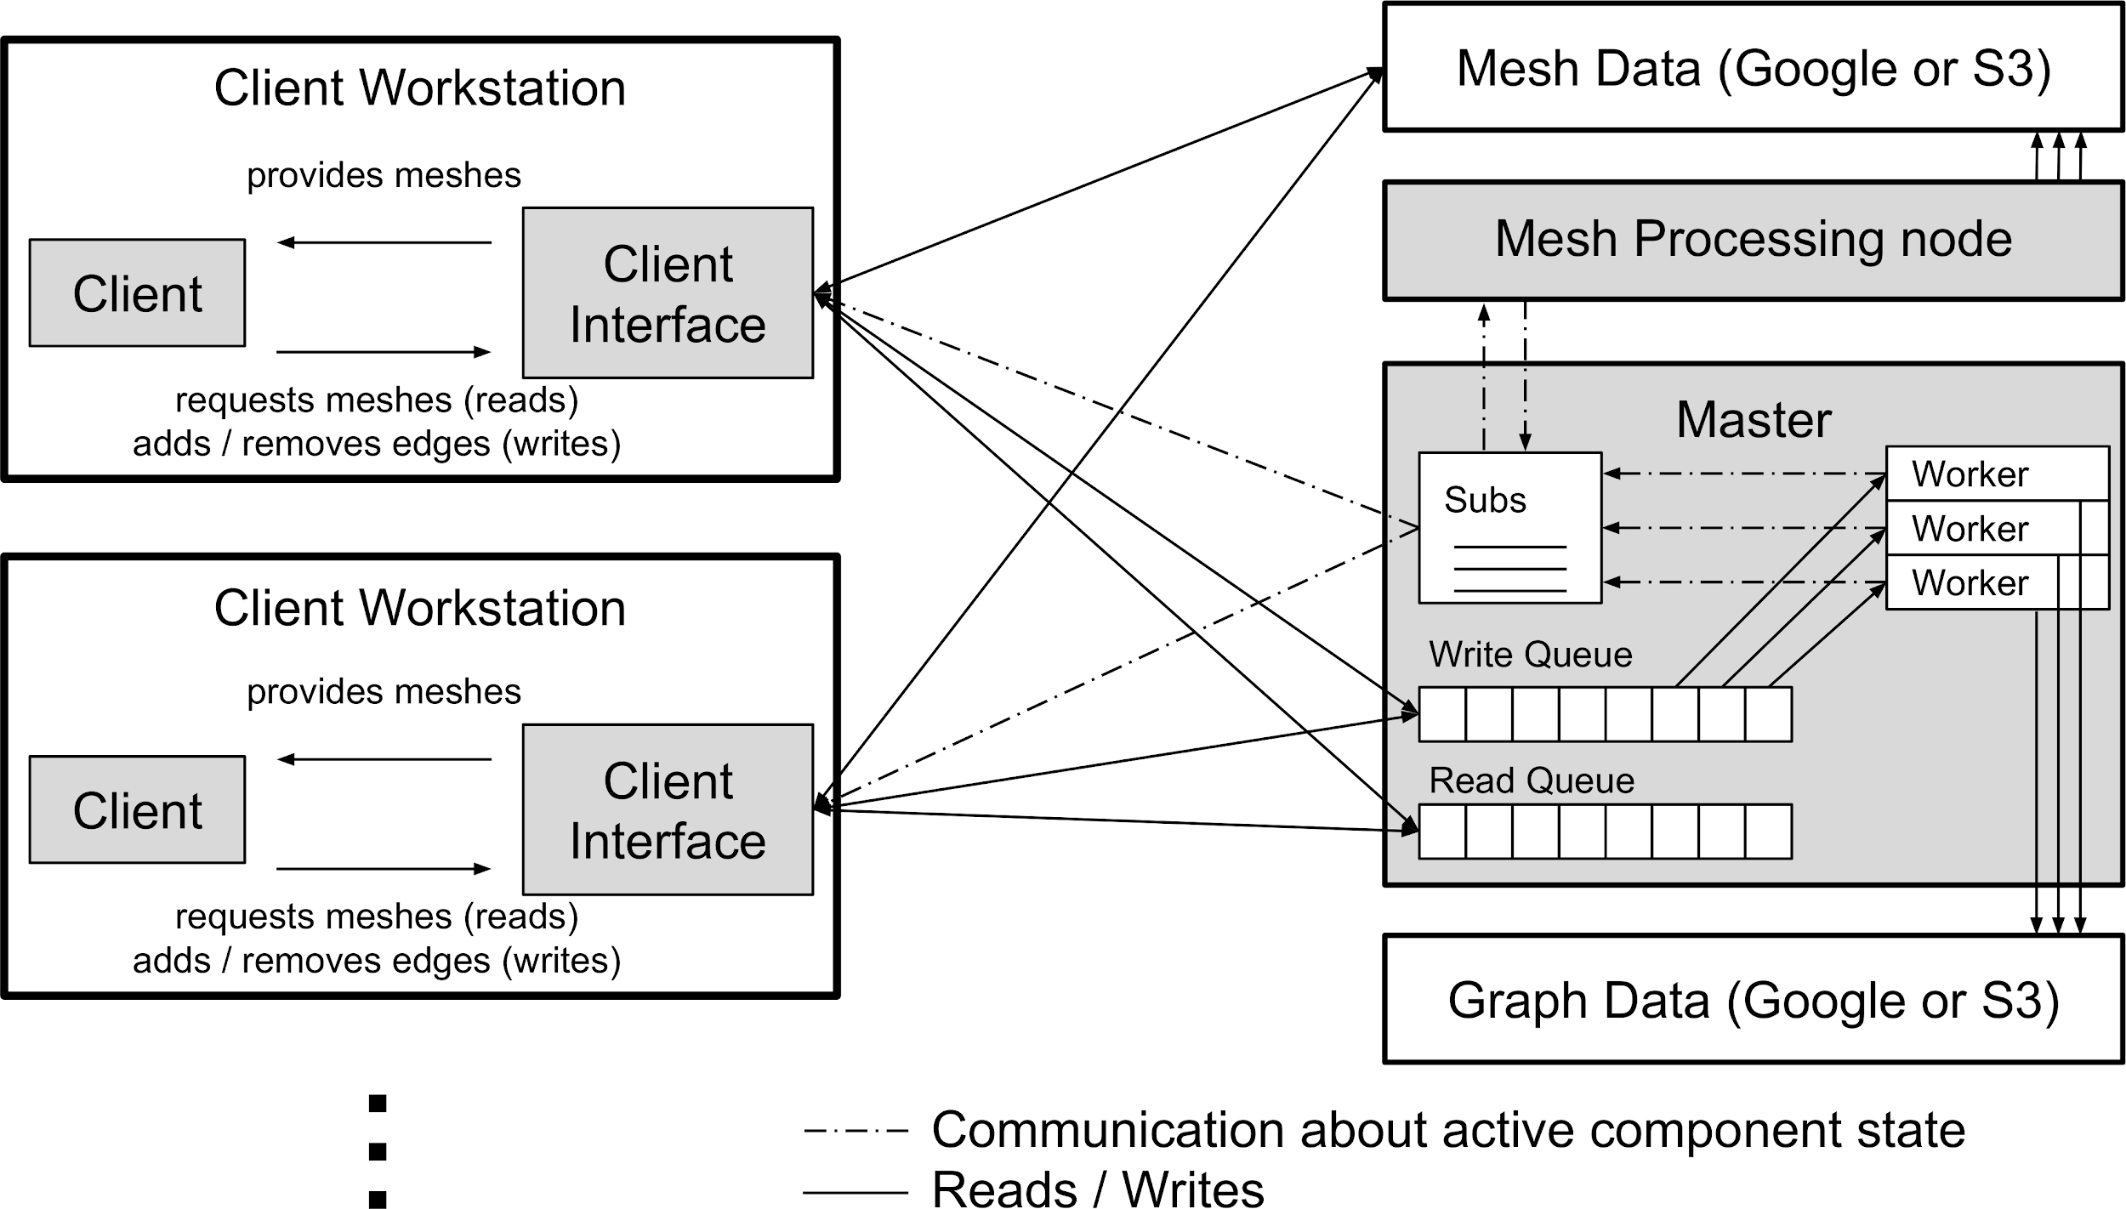
Technical Solution
We can leverage that:
Writes do not conflict
Writes can be processed out of order
But:
We need a global consensus
Versioning:
Add timestamps to edits in the graph server

Slide 9
Implementation Plan
MVP:
System that’s responsive with two people (side-by-side demo)
Stretch:
System that’s responsive with 1000s of people
Fault tolerance
Intermediary mesh displays
Client: Tommy
Master: Zoe
Graph server: Sven

Slide 10
Evaluation Plan
Read latency vs no. of simulated users
Write latency vs no. of simulated users
(QUEUED to COMPLETED, measured @ the master)
No. of nodes in the graph vs no. of writes
(maybe size of graph in TB)

